Slide 1
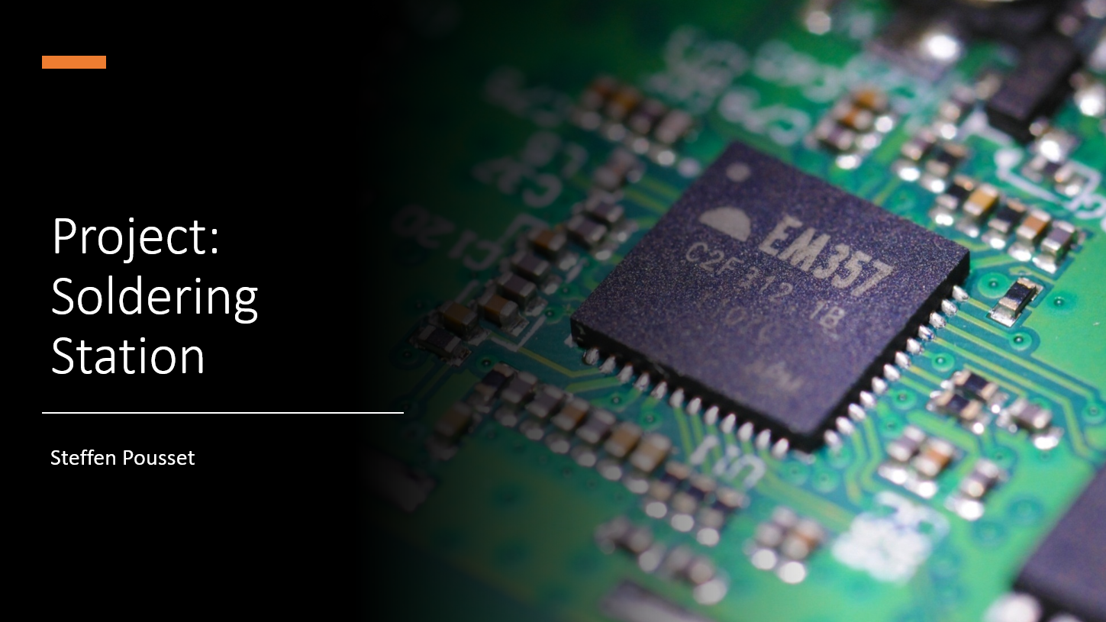

Notes:
Hi before I start my presentation I have a question for you. Do you know the brand jbc that makes soldering stations. We use them in school.
They are good soldering stations but they are very pricey they cost around five hundred euros that
I made a variant of their soldering station for the price of around 250 euros this is half the price.

Slide 2
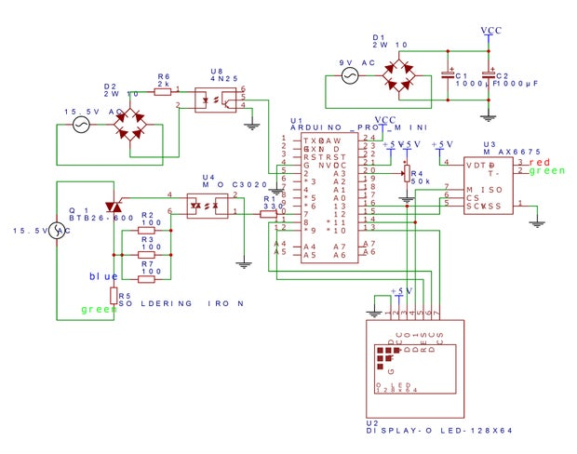
Working:
Optocuplor
Rectifier
Capacitor
TRIAC
MAX6675
Oled
Notes:
First we got the 230V AC from the mains, which was converted to 16v AC using a transformer.
Here the full bridge rectifier will make the ac voltage into a dc voltage.
The capacitors will flat out the curve so the current can be used for powering the Arduino.
The other rectified current goes through the optocoupler, this prevents high voltage which can damage the Arduino.
The Arduino reads this signal and uses it for controlling the voltage for heating up the soldering iron.
Here also is a optocoupler used to prevent damage to the Arduino, the triac is used to switch the ac signal on and off so the temperature will increase and decrease.
The temperature is controlled by the user with a pod resistor. The max6675 is an ic that reads the temperature of the soldering iron and sends it to the Arduino.
The Arduino uses an oled display to display the temperature that the user has chosen and how warm the soldering iron is at that given moment.

Slide 3
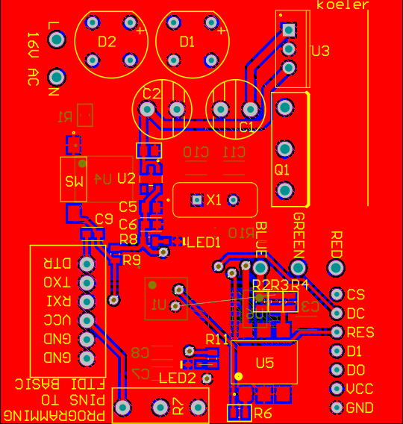
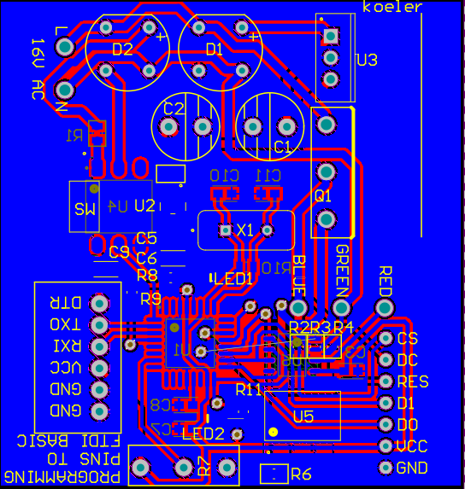
PCB Design:
Placement
Bottom
Top
SMD
Polygon
Notes:
In the PCB design the placement of some components has to be taken into account, such as the pod resistor and the output pins because they must have a specific place on the PCB.
The components that should not go twice in the oven are the most fragile they are placed on the bottom.
The components that have a better durability against heat are placed on the top side. There are also many Surface Mounted Devices (SMD) used so that the PCB can be as compact as possible so components can be placed in the same place above and below.

Slide 4
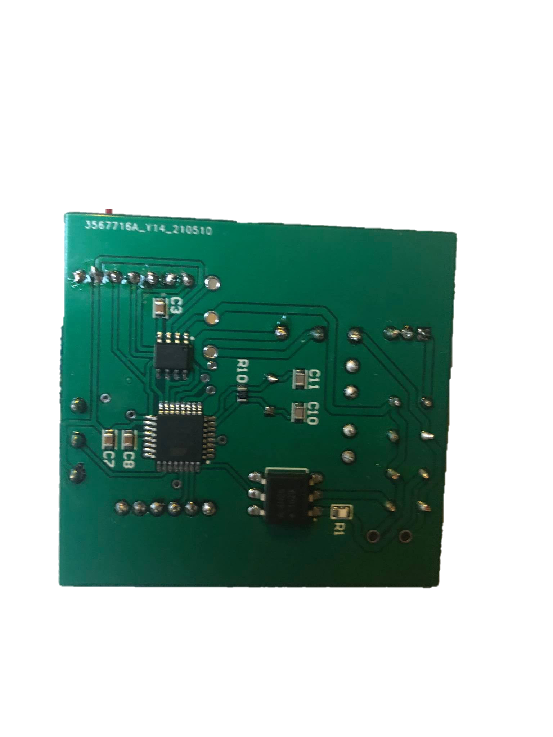
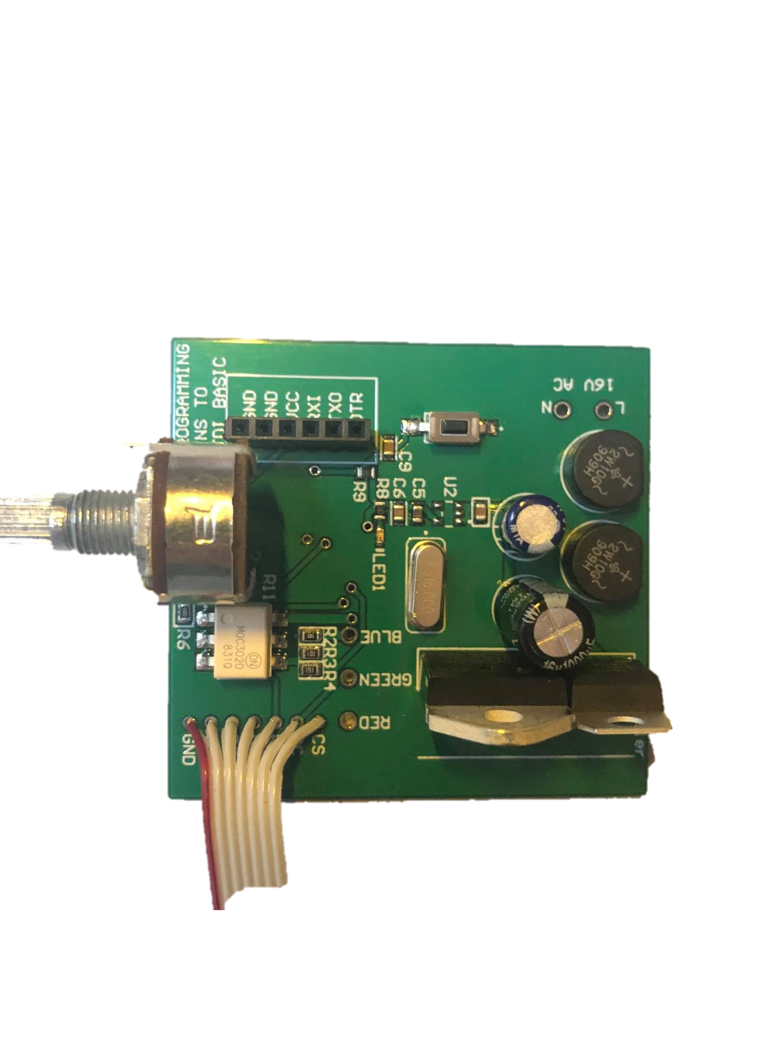
Soldering:
Stencil
Through-Hole
Soldering pad
Notes:
The SMD components are applied by using a soldering paste by placing a stencil then mounting the components with tweezers on the PCB and then putting them in the oven.
The Through-Hole components are all soldered by hand, you have to heat up the soldering pad well with the soldering iron so that the soldering tin is on both sides of the PCB which improves the electrical connection and lessens the loosening of the component.

Slide 5
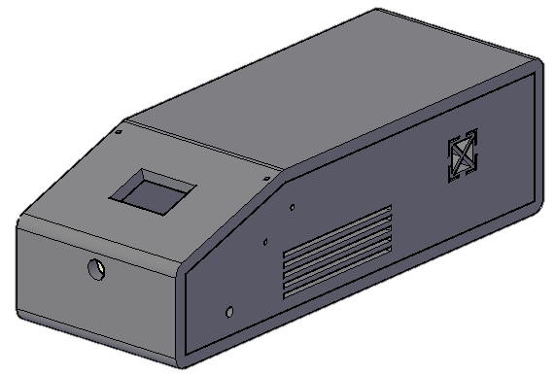
Mechanical Design
User-friendly
Heat sink
Logo
Holder
Notes:
The case is made as user-friendly as possible by putting the rotary knob in a convenient place and placing the oled screen in a angle so that the user sees it more easily.
The side walls are made of plexiglass so you can see the PCB and there are also cooling holes made in the side where a heat sink is placed.
The logo is placed on the left and right side of the case and located on the right side of the case are holes for soldering iron holder.

Slide 6
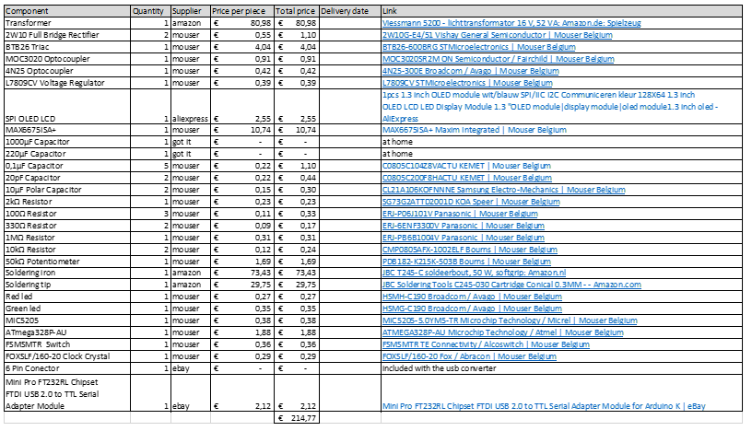
Expenses:
Fairly cheap
Mouser
Extras
Notes:
All components were fairly cheap except 3 components these are the transformer, handle and soldering tip.
Most of the components were purchased from mouser and eBay the oled screen was purchased from aliexpress and arrived surprisingly quickly.
Extras have been purchased for each component so that if one has broken or been lost, there is no need to wait again, and work can continue.

Slide 7
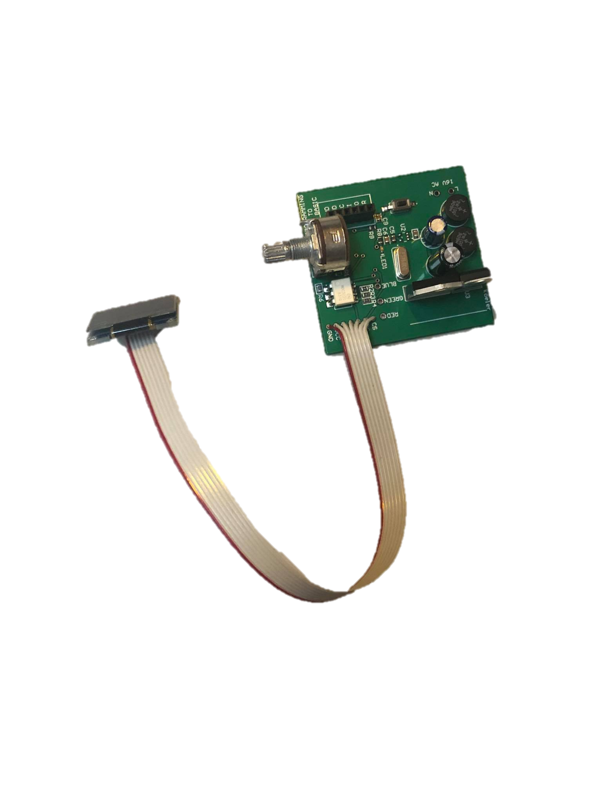
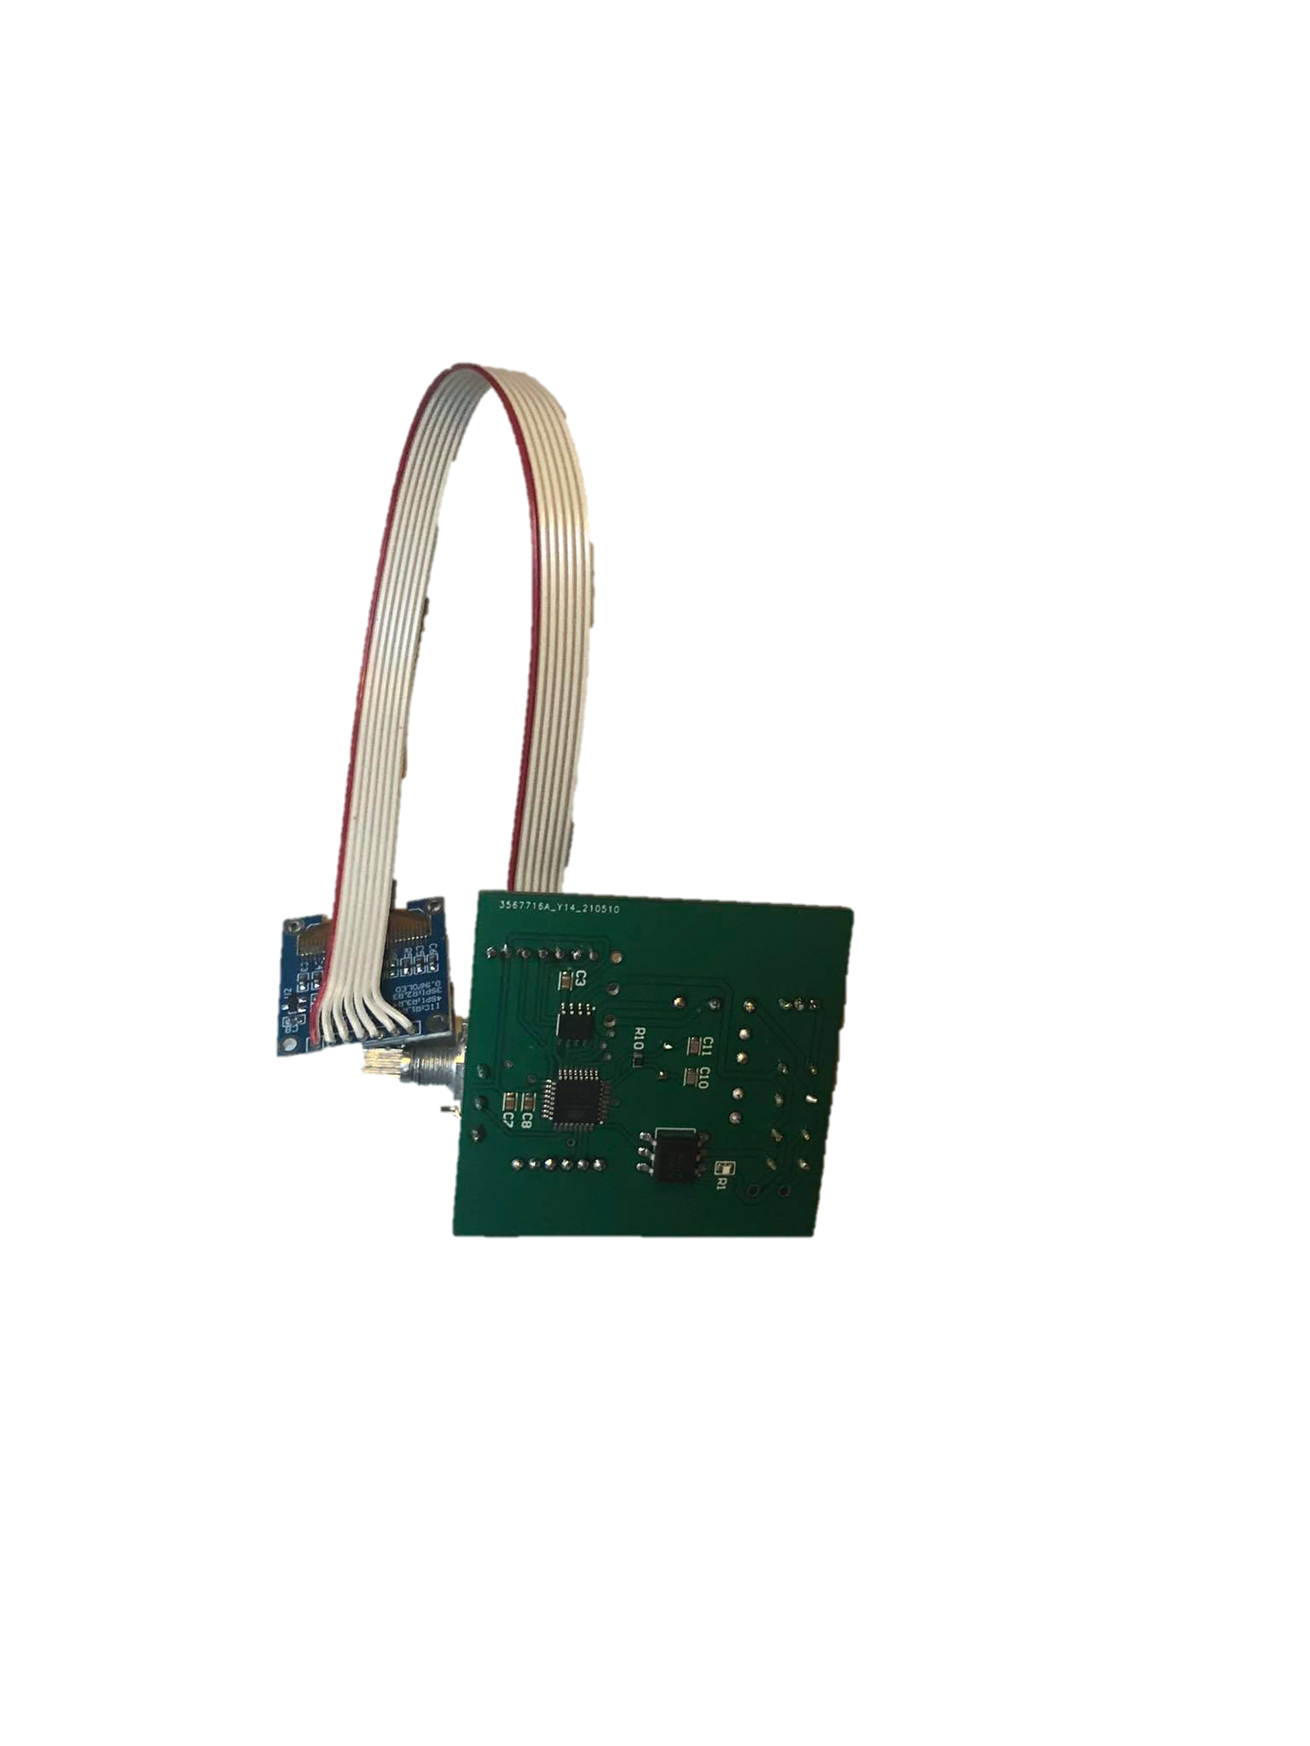
Important Components:
Arduino atmega
MAX6675
L7809CV
MOC3020
Connector
Notes:
Here's The arduino he's the brain of the whole pcb he controls everything.
This is the Max6675's function is to read out the heat sensor and sending it to the arduino.
Here is the L7809 this component converts 16V direct current to 9V for powering the arduino.
The MOC3020 is used for switching the 16v alternating current to control the heat in the soldering iron.
This connector is used to program the arduino chip this is only done once so I did not integrate the converter from USB to serial.

Slide 8
Discussion:
Internal library
Smaller components
3 July
Expensive
Questions
Notes:
The designing of the electrical scheme through Altium went smooth but the components for this project were not in the internal library.
The smaller components needed special attention because they have a small tolerance.
A problem which did occur was the delivery time for each component.
There were also some components that I had to wait for until they were produced because now there is a lot of demand for electrical components.
The project is completely finished but there is one component missing and it will not arrive until 3 July.
A recommendation is to give every student the same project to see how each student develops it in his own way.
Now I'd like to hear your questions.

